Slide 1
Hyperledger Fabric
Theory and Applications of Blockchain (CS61065) - Tutorial 4

Slide 2


Public Blockchains
Anyone can participate.
Every node can see all the transactions in the network.

Slide 3
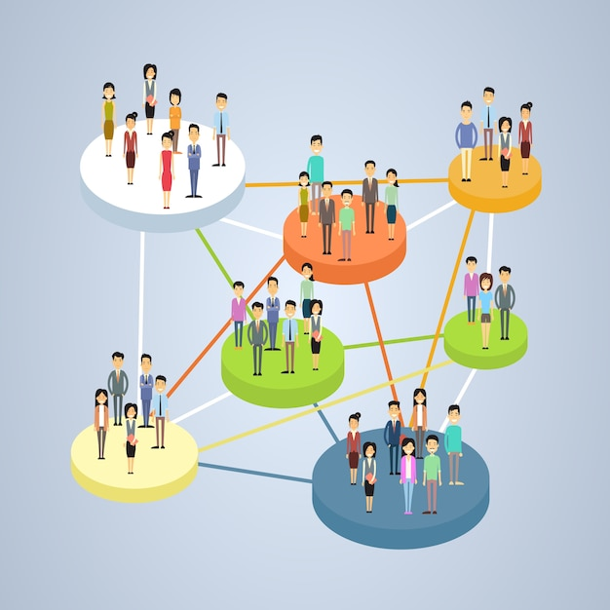

Use case
The class is divided into various groups
Each group has to collectively write some code
If any person makes any changes, he only wants his group to see the changes
No one from outside the class should be able to join without permission.
Can we use a single Public Blockchain network here?

Slide 4
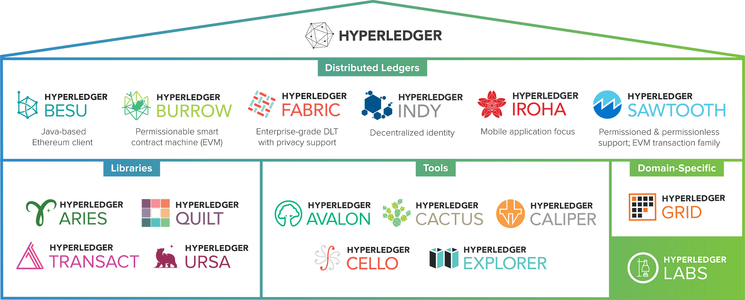
Notes:
There is a project called Hyperledger. There are lot of frameworks under the roof of Hyderledger.

Slide 5
Notes:
There is a project called Hyperledger. There are lot of frameworks under the roof of Hyderledger.

Slide 6
Hyperledger Fabric (Private Blockchain)
Like other blockchain technologies, it has a ledger, uses smart contracts, and is a system by which participants manage their transactions.
It is private and permissioned blockchain.
Rather than an open permissionless system that allows unknown identities to participate in the network, the members of a Hyperledger Fabric network enroll through a trusted Membership Service Provider (MSP).

Slide 7
Hyperledger Fabric Network
Org 1
Org 2
Org 3
Channel 1
Channel 2
Channel 3
World State
World State
World State
Ledger
Ledger
Ledger
Org 4
Org 5
Org 6

Slide 8
Organization
Membership Service Providers (MSP) : Identity management of members
Administrators : To manage the members (enroll, remove etc.)
Users : Typically applications connecting to the blockchain network
Peers : Hosting the chaincode and storing the ledger
Orderers (optional) : Ordering of transactions
Each organization has an ID and a network can have multiple participating organizations

Slide 9
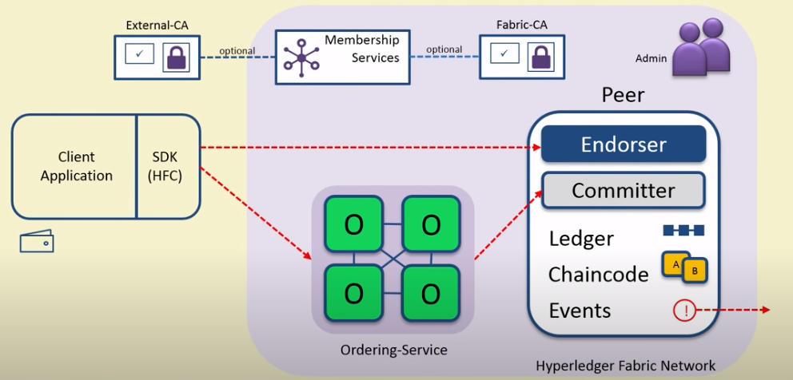
Entities Involved
Image courtesy: NPTEL

Slide 10
Flow of Transactions
Endorse
Orderer
Validate
Client sends the transaction proposal to endorser. The endorsers return results with their signatures. The client checks if the endorsement policy is being satisfied. If yes, it sends the transaction to the orderer.
The orderer simply orders the transactions, puts them into blocks and sends it to all the peers to be validated. It does not have to look at the transactions.
The peers validate the transactions. (Check for double spending, enforcement of the endorsement policy etc.)

Slide 11
Practical Use cases
Walmart and Food Traceability
https://lf-hyperledger.atlassian.net/wiki/spaces/LMDWG/pages/18715588/Walmart
Circulor -Traceability of a Conflict Mineral (Tantalum)
https://lf-hyperledger.atlassian.net/wiki/spaces/LMDWG/pages/18716226/Circulor+-Traceability+of+a+Conflict+Mineral+Tantalum

Slide 12
Setup prerequisites
Recommended to set up on a Linux based system
Git https://git-scm.com/downloads
CURL https://curl.se/download.html
Docker Engine https://docs.docker.com/engine/install/
NodeJS (recommend to use nvm (Node Version Manager))
Docker Compose

Slide 13
Installing Hyperledger Fabric
Determine a location on your machine where you want to place the fabric-samples repository and enter that directory in a terminal window.
>> mkdir fabric
>> cd fabric
>> curl -sSLO https://raw.githubusercontent.com/hyperledger/fabric/main/scripts/install-fabric.sh && chmod +x install-fabric.sh
>> ./install-fabric.sh docker samples binary
>> export PATH=<path to download location>/fabric-samples/bin:$PATH

Slide 14
Starting the test network with CAs
>> cd fabric-samples/test-network
>> ./network.sh up -ca
The script will start containers for each member of the test-network namely:
orderer
peer0.org1.example.com
peer0.org2.example.com
ca_org1
ca_org2
ca_orderer
cli
Notes:
It creates the fabric network that consists of 2 peer nodes and 1 ordering node. No channel is created yet.

Slide 15
Creating a channel
>> ./network.sh createChannel -ca
Creates a channel with name "mychannel"
>> ./network.sh createChannel -c <channel name> -ca
To create a channel with a custom name

Slide 16
Deploying chain-code
>> ./network.sh deployCC -ccn <chain-code-name> –ccp <path-to-chaincode> -ccl <chaincode-language>
To deploy chaincode
Example:
>> ./network.sh deployCC -ccn basic –ccp ../asset-transfer-basic/chaincode-javascript -ccl javascript
Other optional arguments:
-ccep : To specify the endorsement policy

Slide 17
Running an application to invoke the chaincode
Example: Go to the asset-transfer-basic/application-javascript directory
The wallet directory stores the crypto material for a user issued by a CA. The CA is respawned every time we do ./network.sh up.
Before running app.js
Remove the wallet directory before running app.js.
Run >> npm install
To run the app.js file : >> node app.js

Slide 18
Things to remember
asset-transfer-events
While deploying the chaincode for this example, set the -ccep flag to “OR(‘Org1MSP.peer’, ‘Org2MSP.peer’)”

Slide 19
Example – asset transfer basic
cd fabric-samples/test-network
./network.sh down
./network.sh up createChannel -ca -s couchdb
./network.sh deployCC -ccn basic -ccp ../asset-transfer-basic/chaincode-javascript/ -ccl javascript
cd ../asset-transfer-basic/application-gateway-javascript/
npm install
npm start
cd ../../test-network
./network.sh down

Slide 20
Example – asset transfer events
cd fabric-samples/test-network
./network.sh down
./network.sh up createChannel -ca -s couchdb
./network.sh deployCC -ccn events -ccp ../asset-transfer-events/chaincode-javascript/ -ccl javascript -ccep "OR('Org1MSP.peer','Org2MSP.peer')"
cd ../asset-transfer-events/application-gateway-typescript/
npm install
npm start
cd ../../test-network
./network.sh down

Slide 21
References
Hyperledger Fabric Documentation
Endorsement policies — hyperledger-fabricdocs main documentation
Private data — hyperledger-fabricdocs main documentation
Private Data — hyperledger-fabricdocs main documentation - Implicit private data
Hyperledger Fabric SDK for Node.js Interface: Network - BlockEventListeners
Hyperledger Fabric SDK for Node.js Interface: Contract - ContractEventListeners
NPTEL links:
https://youtu.be/4ujj5knD3pg?si=joLsrcNJDv1l7EMk : Fabric Membership and Identity Management
https://youtu.be/xjliVltyLRk?si=IRReh8BBsUDSnWm- : Fabric Components details
https://youtu.be/nBXr7dLXAbE?si=x4vaXCHnM_nLyOGs : Fabric Transaction flow

